Slide 1


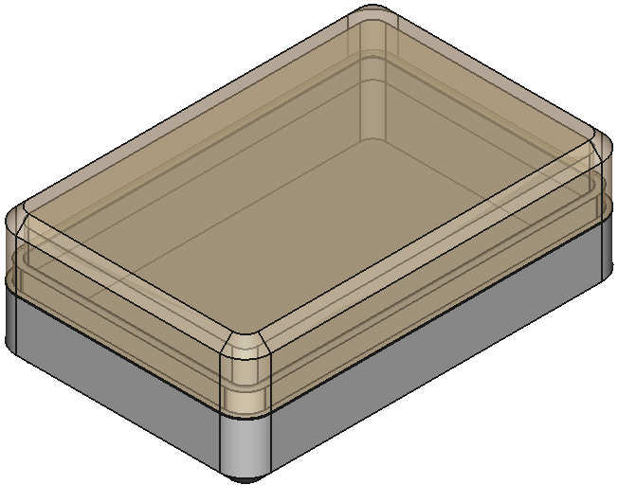
Introduction to FreeCAD
Shawn Hymel (he/him)
Get started!
github.com/ShawnHymel/workshop-freecad

Slide 2




CAD Comparison Chart (2024)
FreeCAD
SolidWorks
Solid Edge
Fusion
Tinkercad
Onshape
Blender
OpenSCAD
Cost for personal
$0
$48 / yr
$0
$0
$0*
$0*
$0
$0
Cost for commercial
$0
~$4000 + ~$1500 / yr*
~$1000 / yr
$680 / yr
$0*
$1500 / yr
$0
$0
Parametric
Open source
Operating systems
Windows, macOS, Linux
Windows
Windows
Windows, macOS
All
All
Windows, macOS, Linux
Windows, macOS, Linux
Runtime
Local
Local + cloud storage
Local + cloud storage
Local + cloud storage
Cloud
Cloud
Local
Local
Features
Ease of use
*Minimum of
2 years
*Autodesk can use your work
*Projects are public and can be used by PTC

Slide 3
Tutorial: Make a Box!
github.com/ShawnHymel/workshop-freecad

Slide 4

Going Further
https://youtu.be/8VPYTTnqmfs?si=1h2JFui7ILt69rM4

